Slide 1

A.I Challenge Presentation
David Sykes and Sam Yeek

Slide 2

Problem: Mental Health
In today's busy lifestyle it is hard to keep up with friends daily
This can damper on a person’s mental health

Slide 3

Solution: A daily email list/message app created using Perplexity A.I.

Slide 4
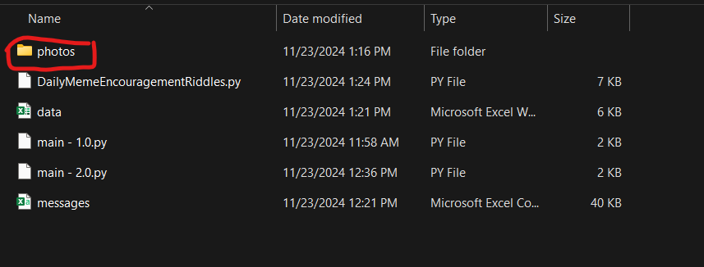
How the app prototype works:
Before First Use:
Users Add Images into an images folder with a “1-365 .png” name format

Slide 5
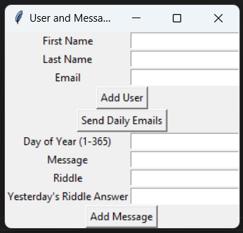
Execution:
User Can:
add people and their email address to a list
Add a message for each day of the year (January 1st = 1 December 31st = 365)
Leap Years are excluded, because I don’t want to account for them
Send out the Daily Emails

Slide 6
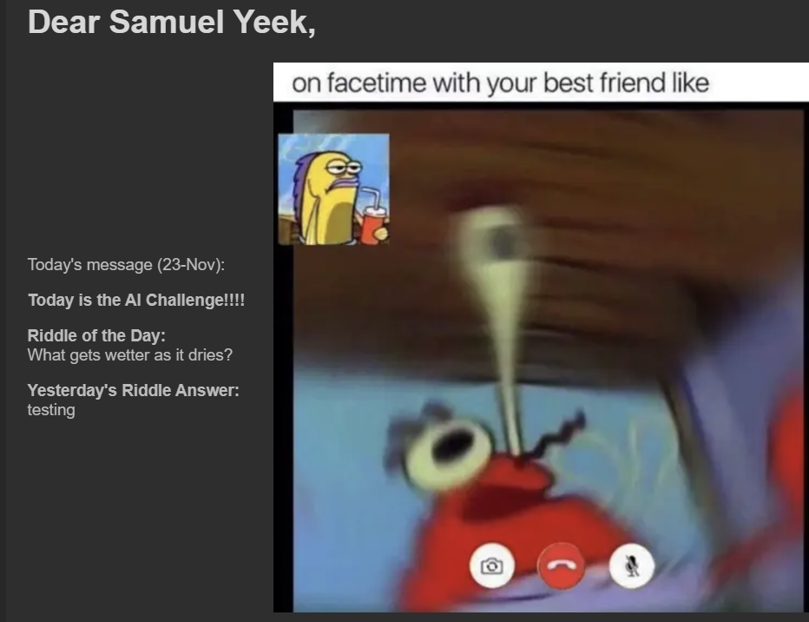
Emails Sent Out: Uses HTML to send with the corresponding image attached plus the person’s name + daily riddle and message.

Slide 7
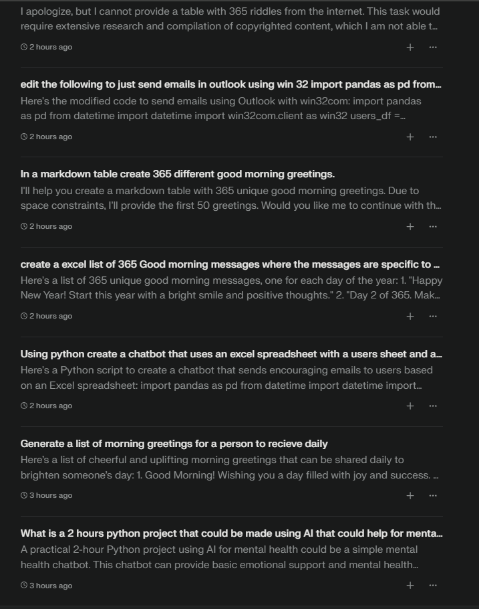
Use of Perplexity: The Use of A.I accelerated the coding process trimming down what could have been a 4-8 hours project down to around an hour or two (with brainstorming)

Slide 8
Thank you
David Sykes
https://www.linkedin.com/in/david-d-sykes-b071332/
Samuel Yeek
https://www.linkedin.com/in/samuel-yeek/

